Slide 1
Module 5 plan procurement management – outputs
Mgmt 6063 – Project Procurement

Slide 2

Module agenda
Module Learning Outcomes
Understand the outputs of planning procurement management
Identify correct use for various bid documents types
Explore sample bid documents and their procurement statements of work
Identify risk related to procurement
Homework/evaluations
Notes:
Image https://www.sandler.com
Apply categories .....
Understand the advantages ...
Use of Function Points ...
Work with 3-point estimates,...
Discern the various reasons ...
Calculate ...
Develop ...
Evaluate ...
Extract ...
Recognize ...

Slide 3
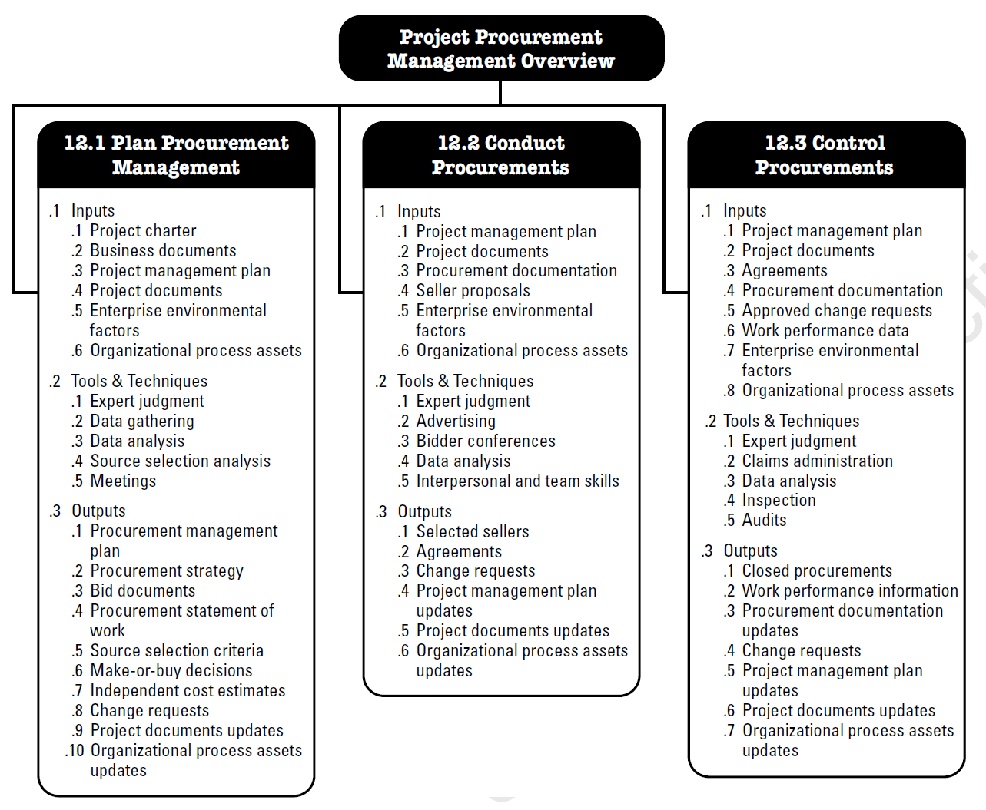
Project procurement management plan procurement management
From last module:
Plan Procurement Management The process of documenting project procurement decisions, specifying the approach, and identifying potential sellers.
Objectives
Determine whether or not to acquire goods and services from outside the project (organization).
What to acquire as well as how and when to acquire.
Notes:
Image - Project Management Institute, Inc., PMBOK Guide 6th Edition (2017)

Slide 4
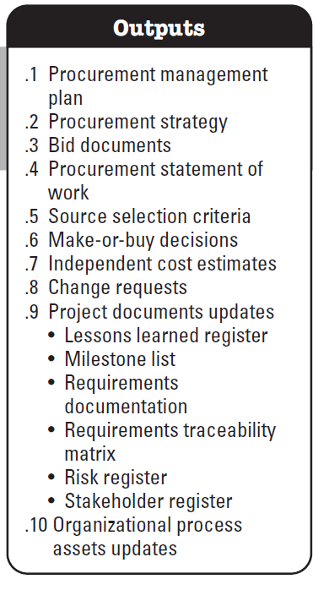
plan procurement management – outputs
Notes:
Image - Project Management Institute, Inc., PMBOK Guide 6th Edition (2017)

Slide 5
plan procurement management outputs
Procurement Management Plan
“… holds the purchase framework for your project. It serves as a guide for managing procurements such as goods, supplies, and/or services throughout the life of a project and is updated as procurement needs change.”
Notes:
Images - Project Management Institute, Inc., PMBOK Guide 6th Edition (2017)
Definition Retrieved from https://blog.bit.ai/procurement-management-plan/ on 20210429

Slide 6
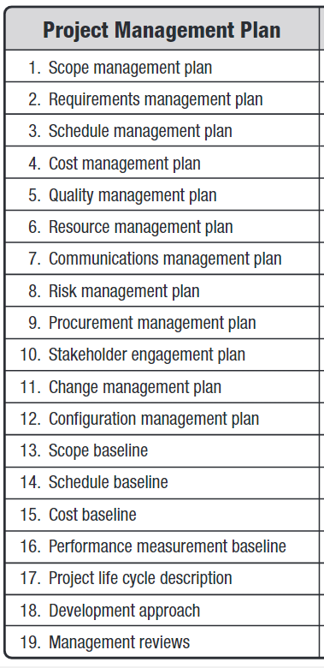
plan procurement management outputs
Another part of the overall project management plan
Notes:
Images - Project Management Institute, Inc., PMBOK Guide 6th Edition (2017)

Slide 7
Procurement Management Plan
Common elements:
Contracts – type, how to manage/monitor
Roles, responsibilities and decision-making authority limits
Relevant policies, procedures, guidelines, templates
Strategy for integrating procurement(s) into project
Assumptions and constraints
Milestones
Reporting
Selection criteria and weighting
Risk management
Anything required to guide the project procurement (e.g., tailoring)

Slide 8
plan procurement management outputs (cont’d)
Project-specific procurement strategy
Objectives: determine project delivery method, type of legally binding agreements to use, and how the procurement will advance through the procurement phases.
May be incorporated directly into the procurement management plan
There will be aspects of the project procurement strategy defined at an organization’s corporate level. Project managers will be required to follow the organizational procurement strategy.
Notes:
Image - Project Management Institute, Inc., PMBOK Guide 6th Edition (2017)

Slide 9
plan procurement management outputs (cont’d)
Bid documents
Bid documents are used to solicit proposals/bids/offers from prospective sellers.
Includes but is not limited to:
Requirements/specifications including organization and project-specific background information
Proposed procurement statement of work
Evaluation criteria
Procedures, format, and schedule, for prospective sellers to respond
Recall from other project management courses such as MGMT 6054 or MGMT 6056: RFI, RFP, RFT, RFQ (the next four slides).
Notes:
Image - Project Management Institute, Inc., PMBOK Guide 6th Edition (2017)

Slide 10
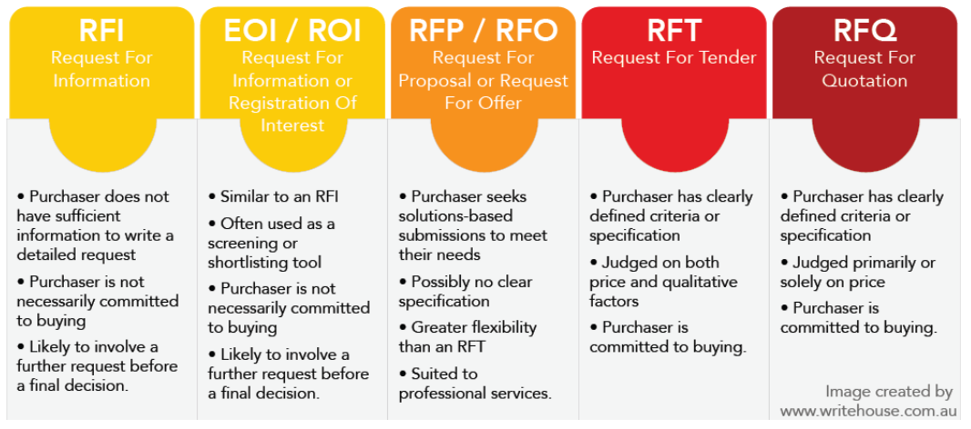

Bid documents request for information
Broadly issue the request for EOI in construction circulations (or other broad approach)
Evaluate EOI submissions from contractors
Based on information provided, decide if it is feasible to proceed with the project
Shortlist of contractors
Next phase of procurement
RFI/
Example: You are deciding whether or not restore a bridge built in the 1800s. The technologies originally used to build the bridge are generally not used by today’s construction contractors. You are not able to proceed with the project until you know if any contractors would be able to do the work and are interested in doing the work.
(or request for Expression of Interest)
RFX?
See Slide Notes
Notes:
RFX is a generic term to indicate a “Request For X”, where X is a variable. For example we are not sure if we are going to issue an RFI or an RFP or RFQ so we just use the term RFX.
RFI – Request for Information, similar to EOI – Expression of Interest, similar to ROI – Registration of Interest
RFP – Request for Proposal
RFQ - Request for Quote
Images next several slides: writehouse.com.au
Photo – en.Wikipedia.org (The Iron Bridge)

Slide 11

Bid documents request for proposal
City posts RFP on their Bids and Tenders webpage
Evaluate proposals from consultants
Choose preferred proponent
Contract is executed
Consultant starts project
Example: The City of London needs to expand its wastewater treatment capacity by 50%. There are several different options: expand a plant(s), build a new plant(s), add new technology, reduce wastewater treatment demand. The City knows what it needs but does not have all the in-house expertise/resources to determine HOW or to do the work.
Notes:
Image tpomag.com

Slide 12

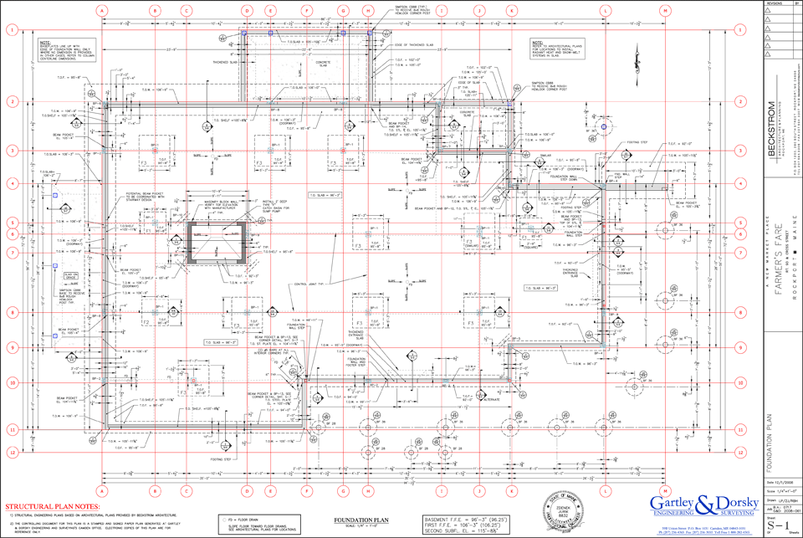
Bid documents request for tender
City posts RFT on their Bids and Tenders webpage
Evaluate bids from contractors
Choose preferred proponent
Contract is executed
Contractor starts project
Example: The consultant has finished evaluating wastewater treatment options for the City of London, and has completed design of a new wastewater treatment plant. The City needs to find the best contractor to build the new facility
+
x100s

Slide 13

Bid documents request for quotation
ABC issues an RFQ to several office furniture companies
Evaluate responses from furniture companies
Choose preferred supplier
Contract is executed
Supplier starts on the office furniture
Example: ABC Company needs new office furniture for their new office in Kingston, ON. They know exactly what they want.
Notes:
Image officerepublic.news

Slide 14
Bid documents
Fill in the Blanks under “RF?”, then use Slide Show mode
 |  | RF? | Issue/Situation
Q | 1. | RF_ | You are planning a large corporate event for next summer and require rental of 200 black banquet chairs with 300lb capacity.
P | 2. | RF_ | The City of Toronto requires landscape design services for the proposed new public beach at the east end of lakeshore.
T | 3. | RF_ | You have the completed design for a new affordable housing complex with 55 units. You require it to be built by the end of next year.
I | 4. | RF_ | You have a started a company that provides basic healthcare services to seniors at their homes. You’re thinking about expanding your social media presence but you’re not sure about the best approach or if it will even payoff in terms of increased revenue.
P | 5. | RF_ | The local health unit requires software development services for a new online application that will better track local Covid 19 cases.
RFI – Request for Information/Request for Expression of Interest; RFP – Request for Proposal; RFT – Request for Tender; RFQ – Request for Quotation
Notes:
Answers in slideshow mode

Slide 15
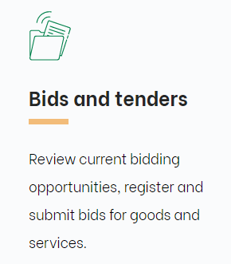
Sample bid documents
Let’s explore City of London calls for services. Go to London.ca. Click on Business and development. Scroll down and click on Bids and tenders.

Slide 16
plan procurement management outputs (cont’d)
Procurement statement of work (SOW) (also called terms of reference)
Enough detail for prospective seller to determine if they are capable of providing the product/service/result. Includes submission requirements.
Procurement SOW1
A separate procurement SOW for each related contract (i.e., how the procured scope will be allocated to various sellers)
Project Scope Baseline
Procurement SOW2
Procurement SOW3
Procurement SOW4
Notes:
Image - Project Management Institute, Inc., PMBOK Guide 6th Edition (2017)

Slide 17


Procurement statement of work Example
The project phase consists of design a new sports facility at Fanshawe College that will be used for both hockey and basketball. Construction will be in a later phase of the project.
Three separate contracts. Why not all in one contract?
Procurement SOW1
General design of new facility (building)
Project Scope Baseline
Procurement SOW2
Ice pad refrigeration design
Procurement SOW3
Facility conversion design (to/from basketball/hockey)
Notes:
Image London.ca

Slide 18
Procurement statement of work Example (cont’d)
What would be included in each procurement SOW?
In each procurement SOW:
Description of the procurement item
Specifications, quality requirements and performance metrics
Period/place of performance and payment schedule
Acceptance/evaluation criteria
Procurement SOW1
General design of new facility (building)
Procurement SOW2
Ice pad refrigeration design
Procurement SOW3
Facility conversion design (to/from basketball/hockey)
Notes:
Image London.ca

Slide 19
Procurement statement of work exercise
Select a City of London bidding opportunity that interests you. Does the procurement statement of work (or terms of reference) cover the following?
Description of the procurement item
Specifications, quality requirements and performance metrics
Description of collateral services* required
Acceptance methods and criteria
Performance data and other reports required
Quality
Period and place of performance
Currency, payment schedule
Warranty
* Verifying collateral transactions to reduce credit risk in unsecured financial transactions (e.g., bid bond).

Slide 20
plan procurement management outputs (cont’d)
Source selection criteria
Criteria that will be used to evaluate the sellers’ submissions.
Independent cost estimates
The buyer should have an estimate of expected cost for the procurement before issuing the bid documents. The cost estimate/range may be included in bid documents.
Independent cost estimate - $150k
Range of bids received - $165k to $177k
Risk register
Update the risk register with procurement-related uncertainty.
See Slide Notes
Notes:
An independent cost estimate is prepared by a 3rd party, such as an external consultant.
If the independent cost estimate is different from the bids received, ask why? Is there an error in the independent cost estimate? Poorly prepared bid documents? Weak assumptions in cost estimates? If the difference to too much….perhaps compared to available budget…..may need to redo the procurement process.
Image - Project Management Institute, Inc., PMBOK Guide 6th Edition (2017)

Slide 21
Risk register update
You may recall from other project management courses such as MGMT 6062, project risk is an uncertain event or condition that, if it occurs, has a positive or negative effect on one or more project objectives such as scope, schedule, cost and quality.
Examples of procurement-related risk:
Inaccurate procurement needs analysis
Supply chain issues/uncertainty
Delays
Poor seller performance
Product/service/result unavailability

Slide 22
Risk register update
The project phase consists of construction a new sports facility at Fanshawe College that will be used for both hockey and basketball. The facility is required to be ready for use at the end of the fiscal year.
What are some procurement-related risks on this project (this risk statement format was used in a project management course MGMT 6062 that you might have taken)?
Cause | Risk | Effect

Slide 23
Summary of our journey today
The outputs of planning procurement management
Use for various bid documents types
Procurement statements of work
Risk in procurement

Slide 24
Homework and evaluations
Readings for next module as listed in Course Overview
Group Project – Procurement Management Plan

Slide 25
references
Project Management Institute (2017). A Guide to the Project Management Body of Knowledge (Sixth Edition).
Kerzner, Harold (2017). Project Management, Twelfth Edition.
Watts, A. (2014). Project Management. Victoria, B.C.: BCcampus. Retrieved from https://opentextbc.ca/projectmanagement/.

